Slide 1

Nelson County Generator Replacement Project

Slide 2
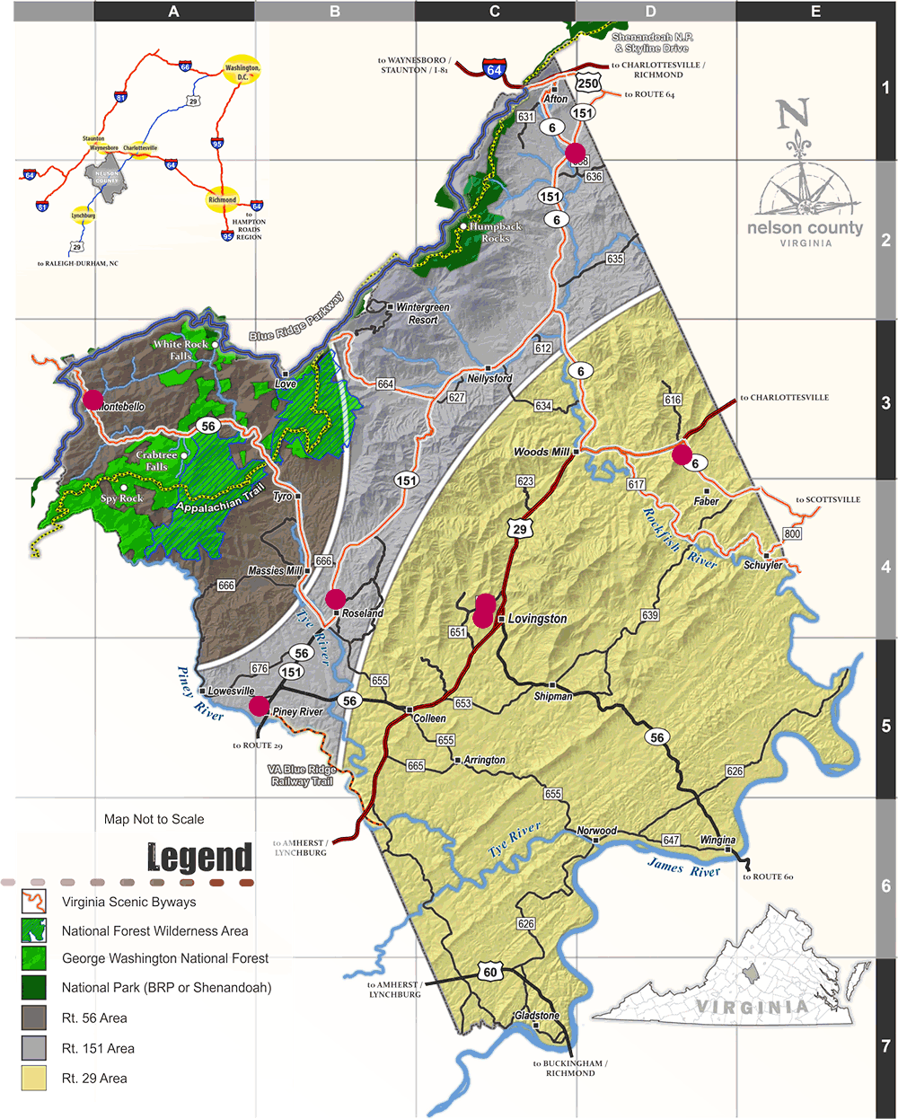
Seven Locations in the County

Slide 3
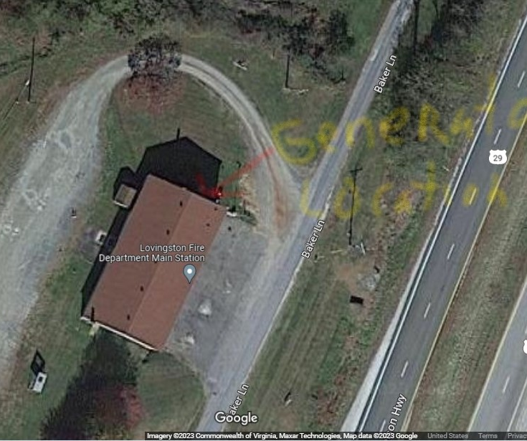
Lovingston Fire

Slide 4
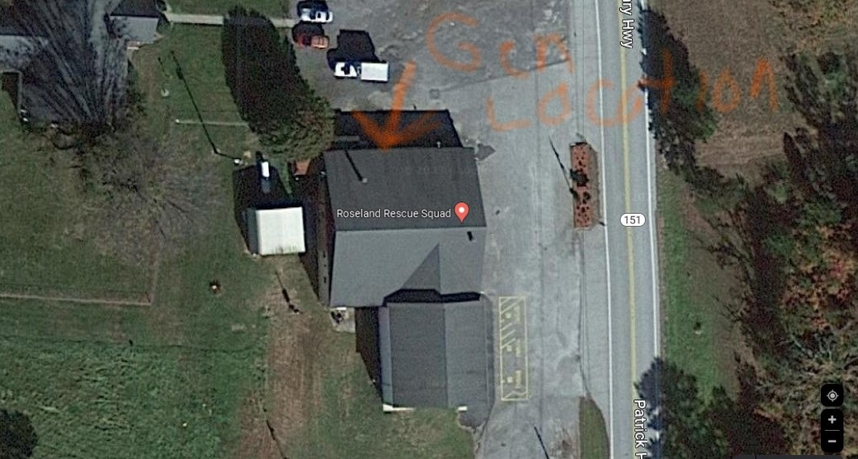
Roseland Rescue

Slide 5
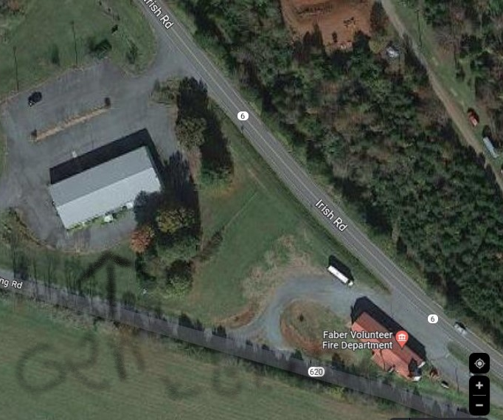
Faber Fire

Slide 6
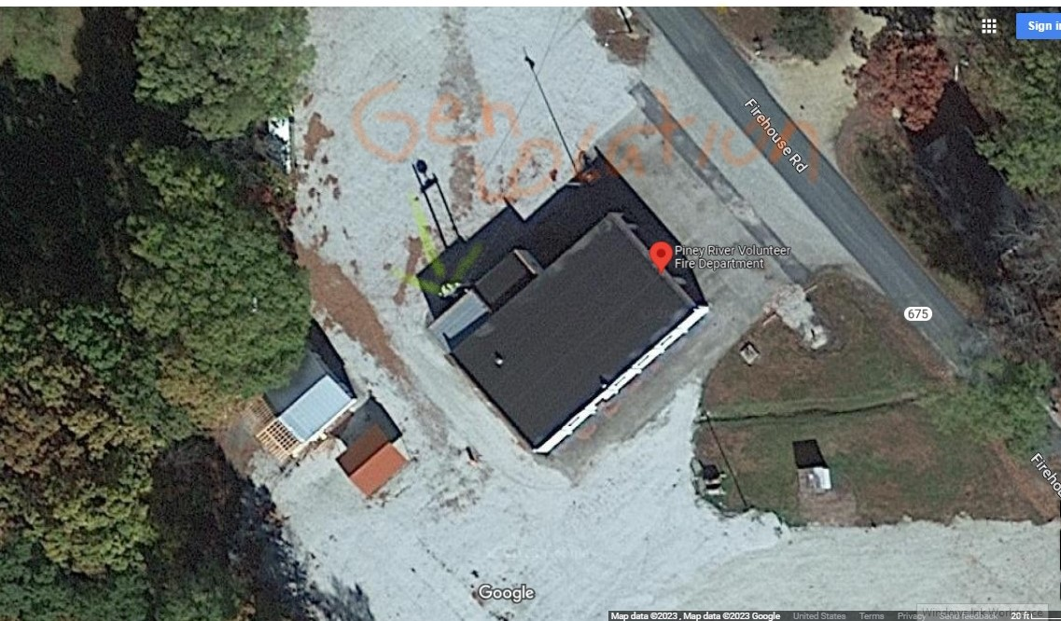
Piney River Fire

Slide 7
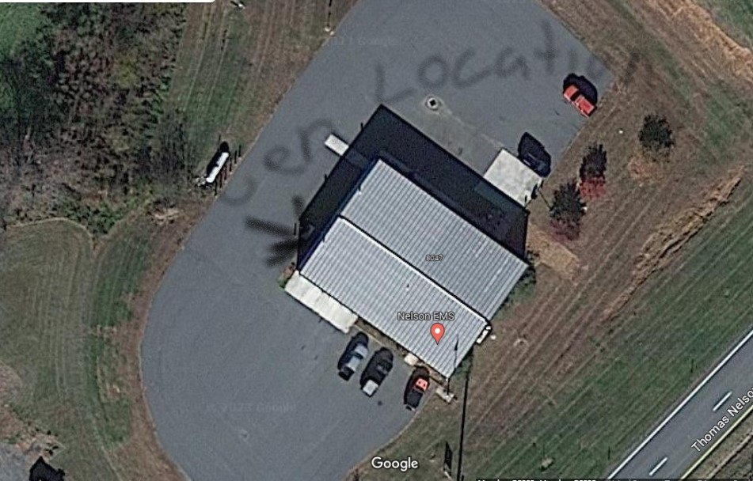
Nelson EMS

Slide 8
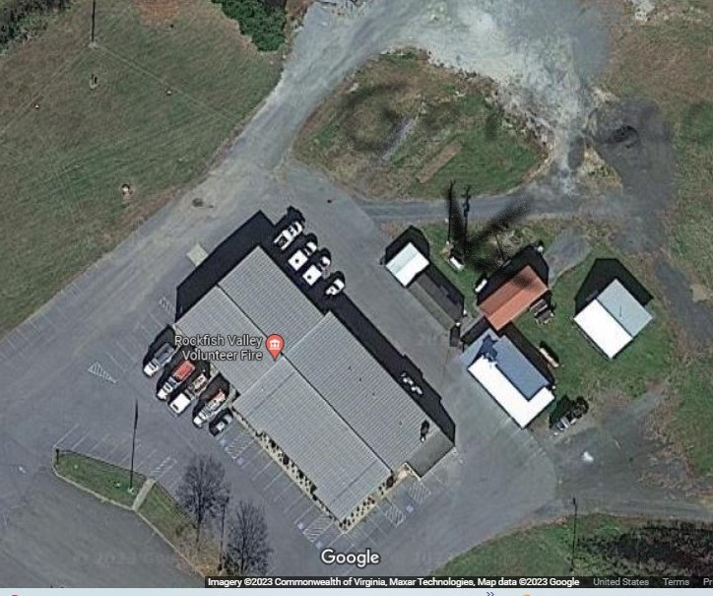
Rockfish Fire

Slide 9
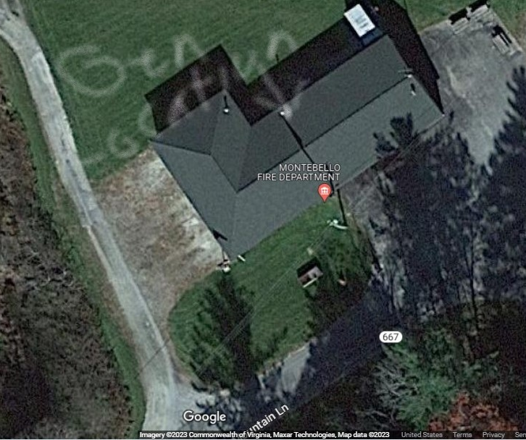
Montebello Fire

Slide 10
Priority List
1. NEMS
2. Lovingston Fire
3 Rockfish Fire
4. Faber Fire
5. Roseland
6. Piney River
7. Montebello

